Slide 1
Warehouse Automation
Title: Warehouse Elbow Detection Using YOLOv8
Subtitle: Computer Vision Automation Project
Author: Cesar Noriega
Date: December 2025

Slide 2
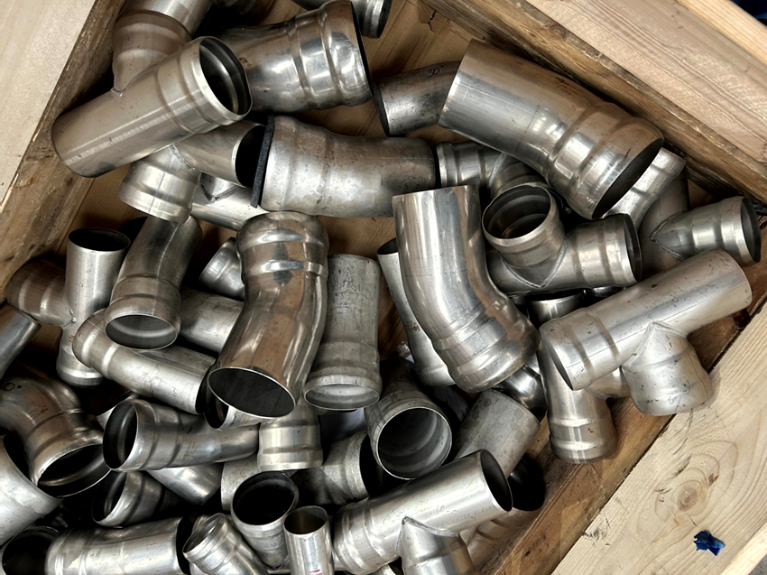
Warehouse Automation
Goal: Automate the detection of elbows inside warehouse boxes to support inventory, classification, and automation tasks.
Challenges:
Manual counting is slow and error‑prone
Items vary in position, lighting, and orientation
Need a fast and reliable detection system

Slide 3
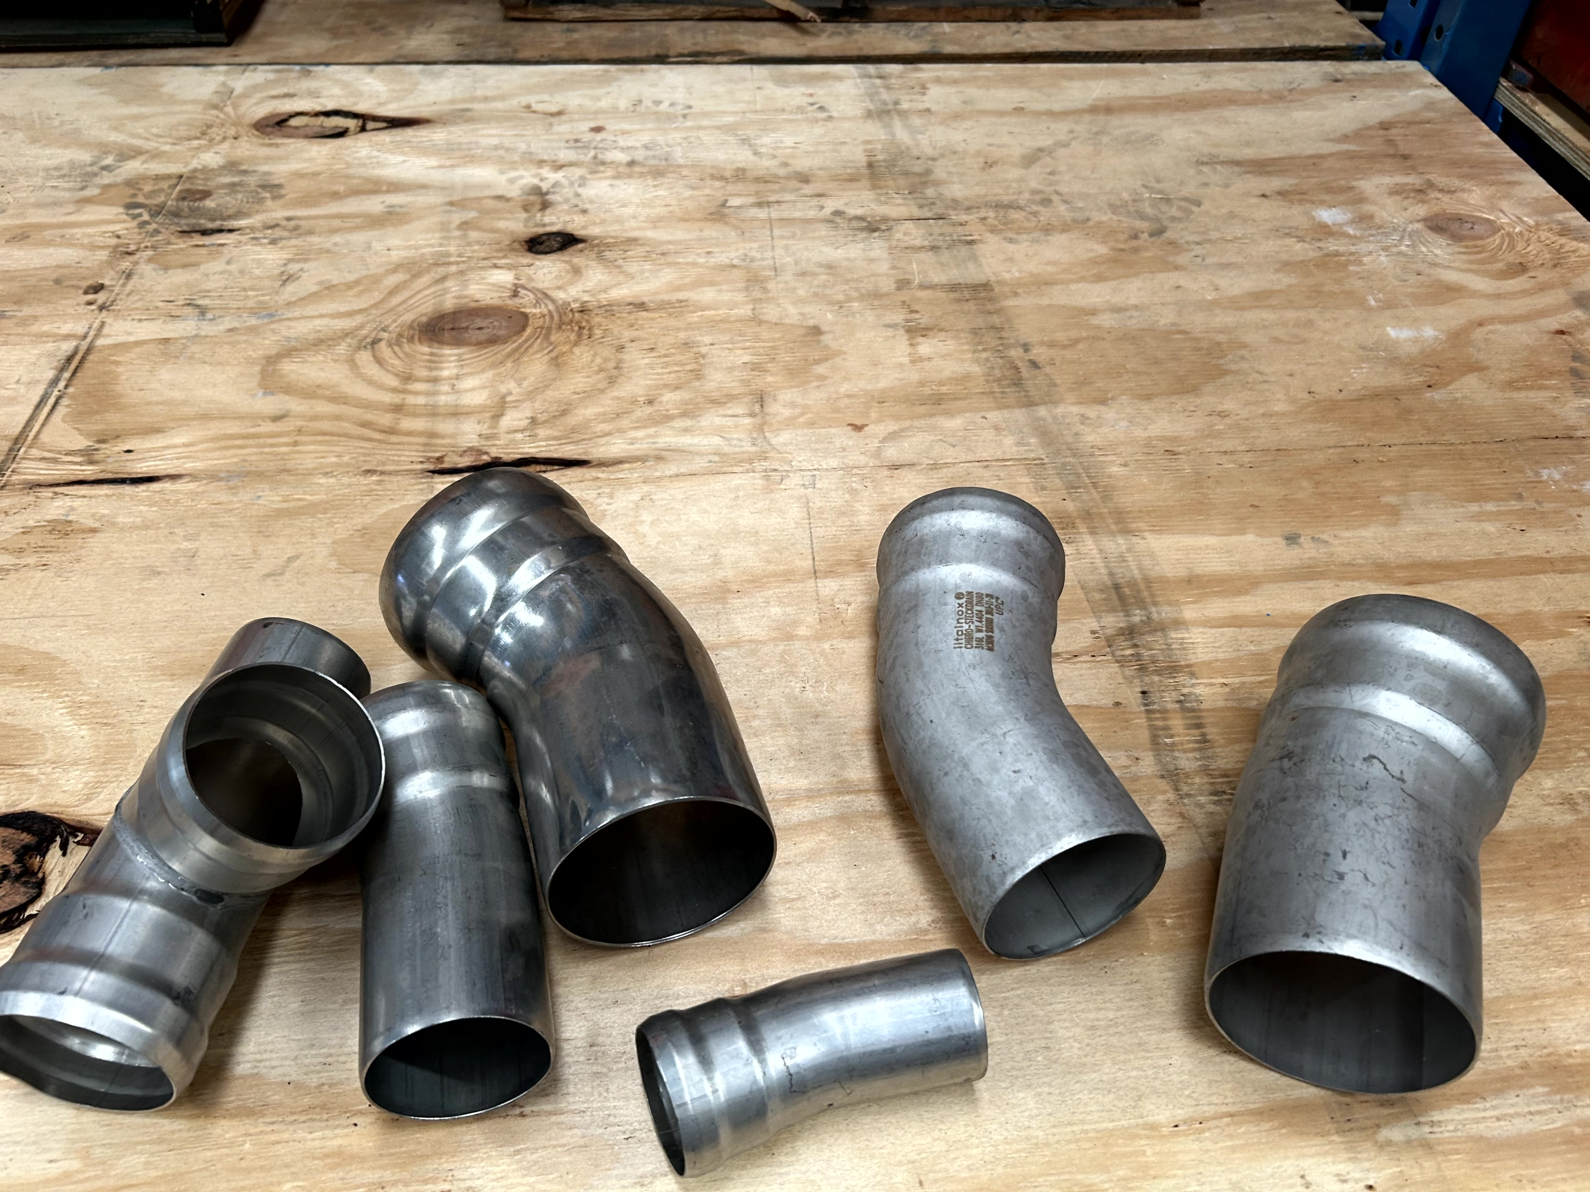
Warehouse Automation
Data Collection
Source: 219 warehouse photos containing elbows inside boxes.
Selection: From the full set, 30 representative images were chosen for the training dataset.
Variations included:
Different angles
Different lighting conditions
Different elbow positions

Slide 4
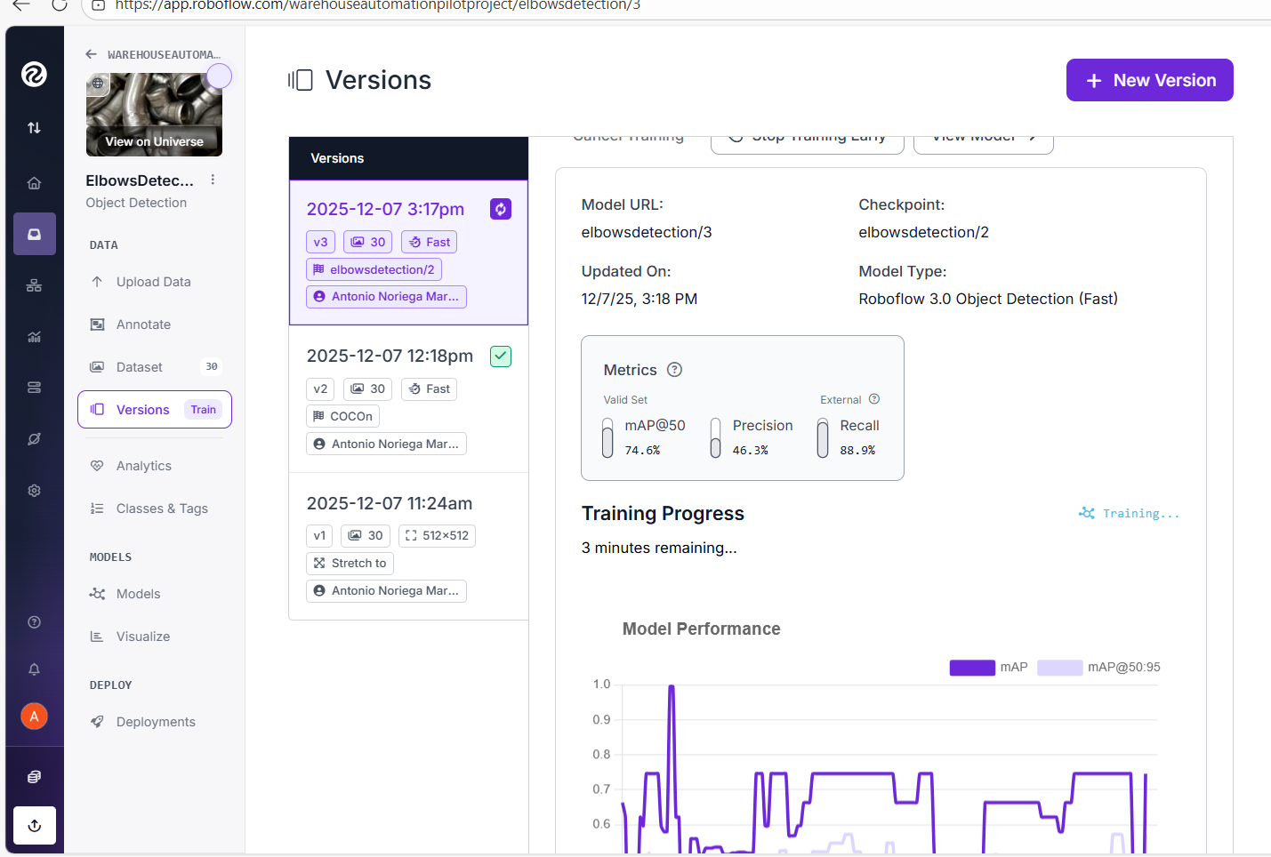
Warehouse Automation
Annotation Process
Tool: Roboflow Annotate
Label: elbow (single class)
Steps:
Uploaded images
Drew bounding boxes around each elbow
Verified annotation consistency
Outcome: A clean, high‑quality dataset ready for training.

Slide 5
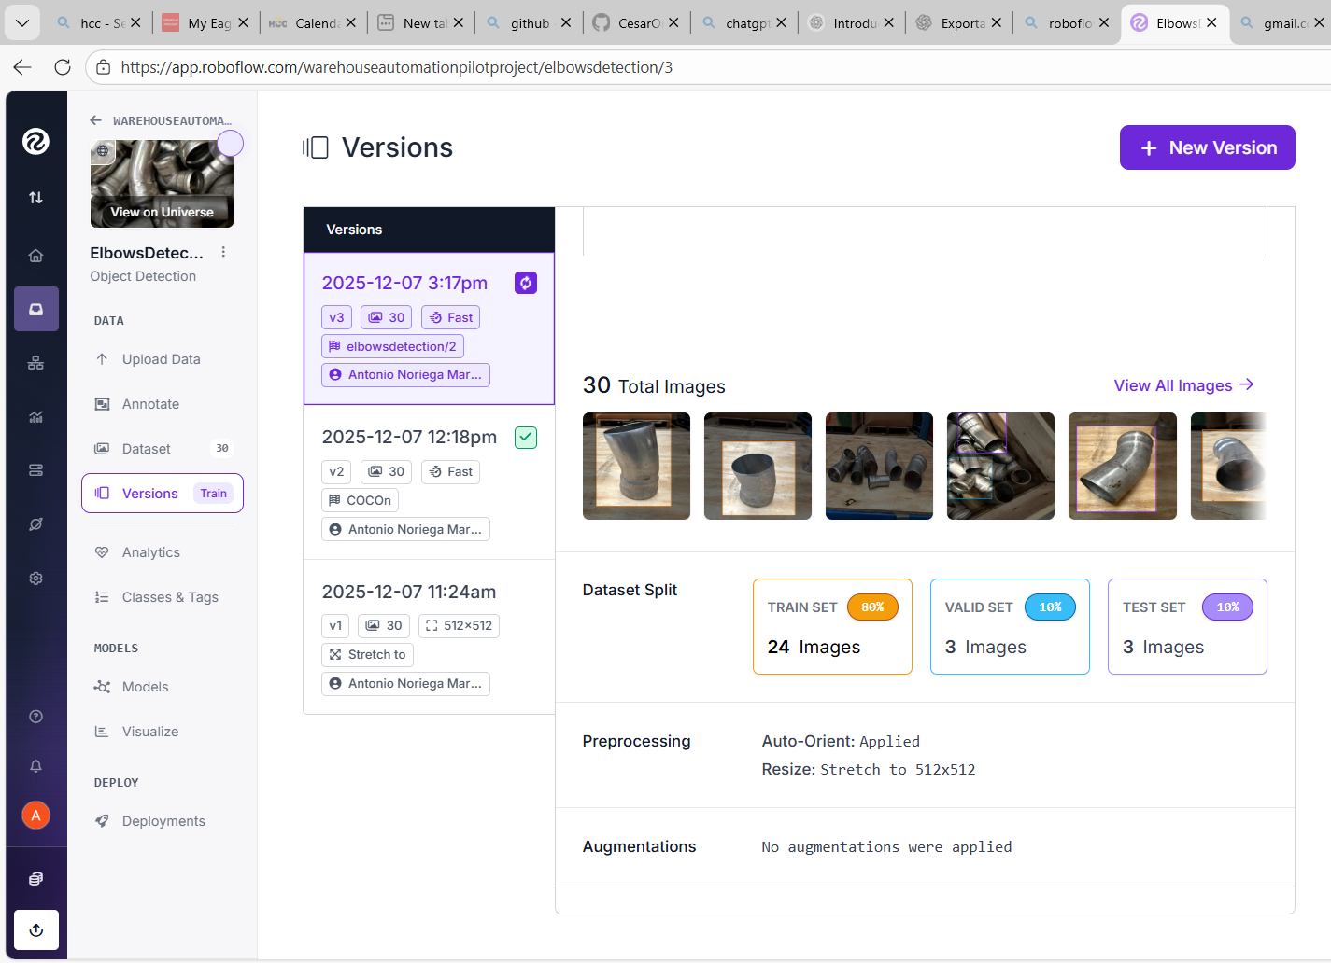
Warehouse Automation
Dataset Versioning
Preprocessing:
Resize: 512 × 512
Auto‑orient: Enabled
Augmentation: None (for this version)
Train/Validation/Test Split:
Train: 80%
Validation: 10%
Test: 10%
Dataset Version: v2

Slide 6
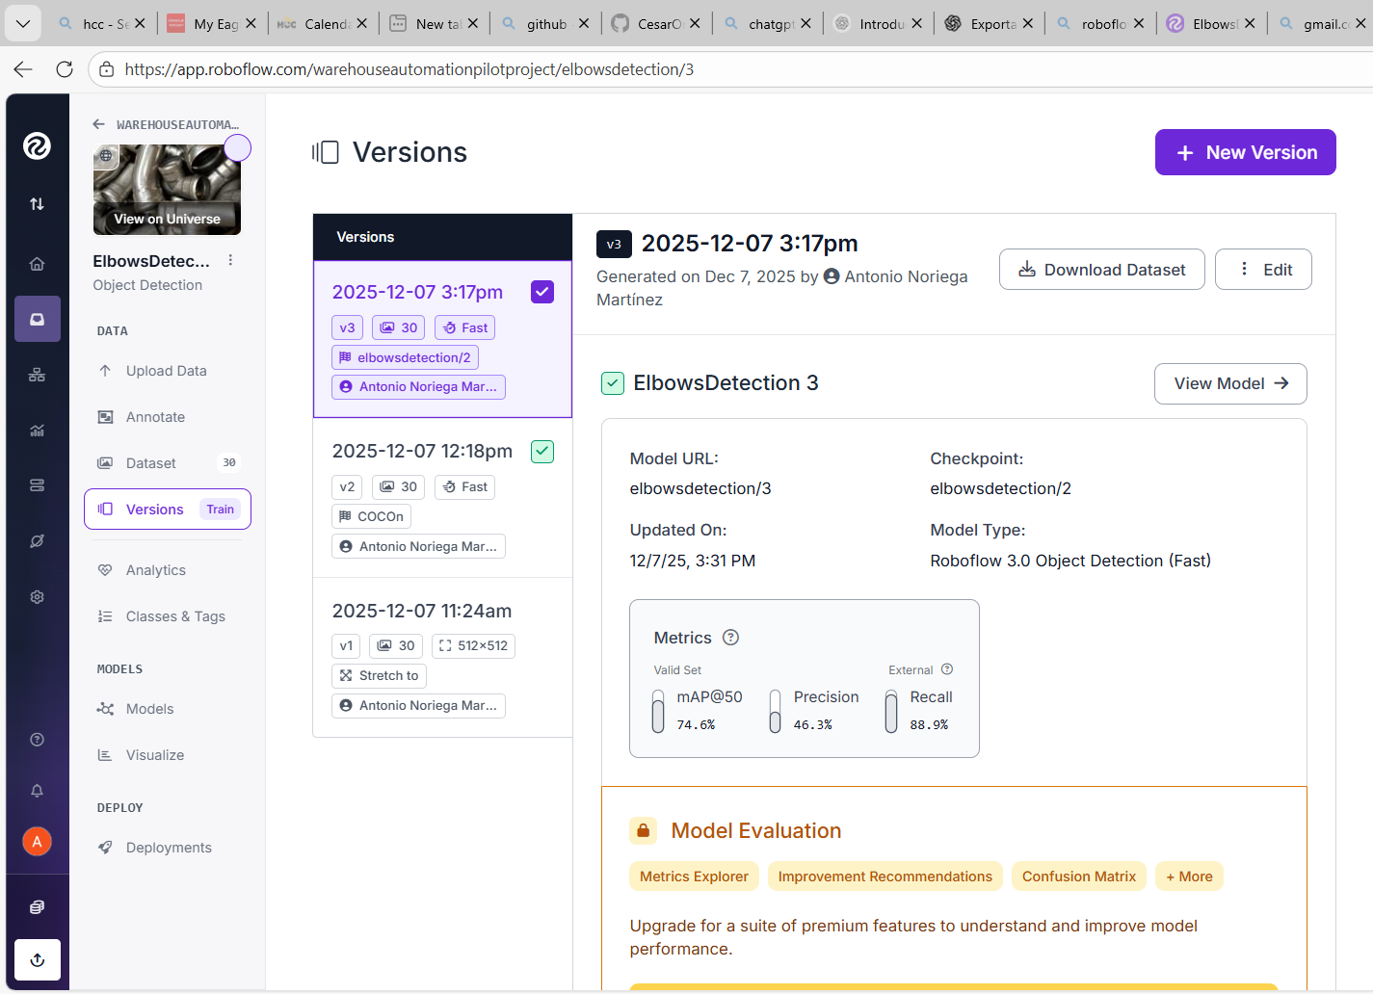
Warehouse Automation
Model Training
Framework: YOLOv8 (Roboflow 3.0 Object Detection – Fast)
Training Configuration:
Public checkpoint
30 images
Automatic hyperparameters
Cloud GPU training
Status: Training completed (or in progress depending on your timing).

Slide 7
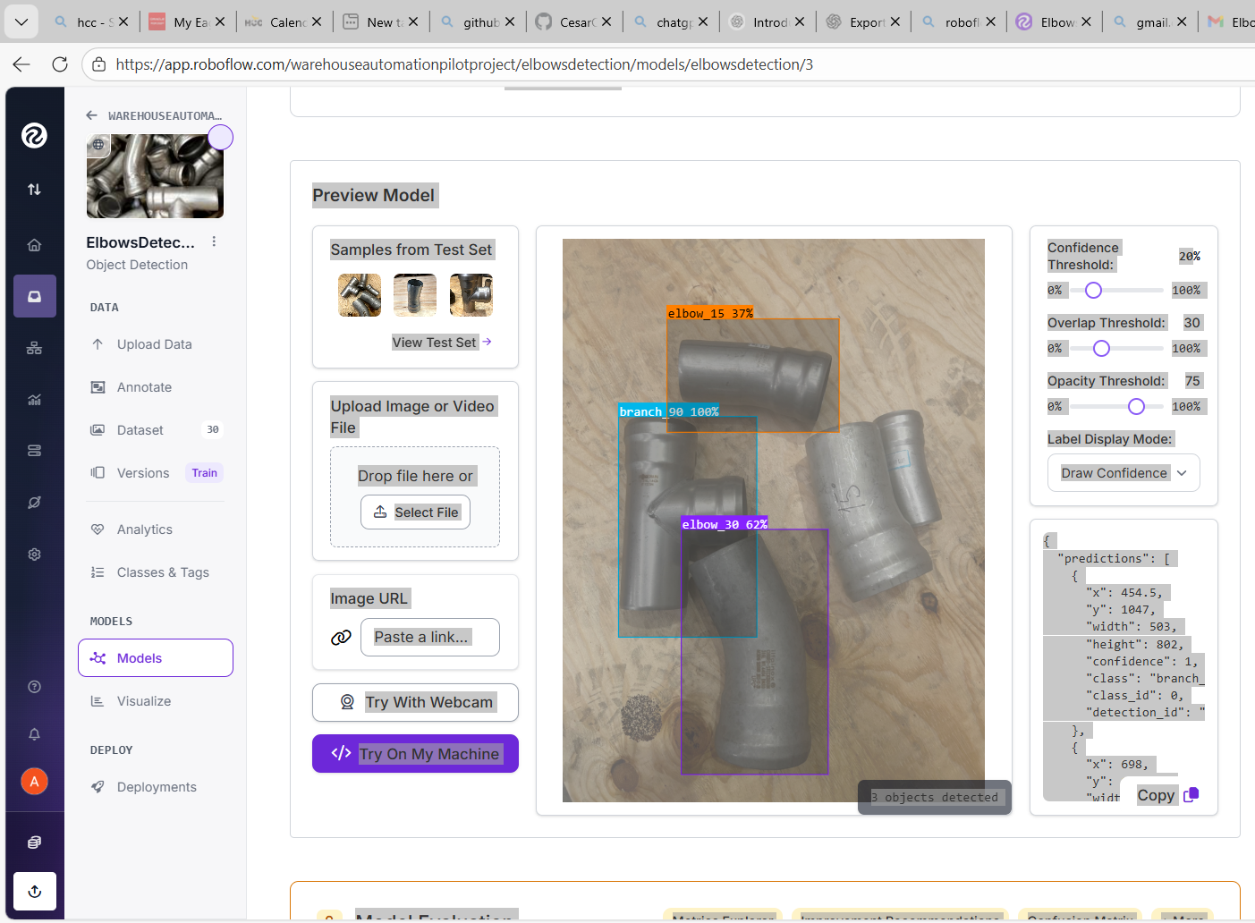
Warehouse Automation
Model Performance
(Fill this slide once training finishes)
Include:
mAP@50
Precision
Recall
Loss curves (optional screenshot)
Interpretation: Explain whether the model is performing well and detecting elbows reliably.
The trained Roboflow Object Detection model successfully identified all three target classes in the test image.
Detected objects include:
branch_90 (confidence: 1.00)
elbow_30 (confidence: 0.616)
elbow_15 (confidence: 0.37)
The model was evaluated using mAP@50, precision, and recall metrics, achieving:
mAP@50: 74.6%
Precision: 46.3%
Recall: 88.9%
These results demonstrate that the model is capable of distinguishing between different elbow types and pipe branches within the dataset.

Slide 8
Warehouse Automation
Inference & Results
Testing:
Ran inference on new images
Model successfully detected elbows
Bounding boxes were accurate and stable
Applications:
Counting elbows
Quality control
Automation workflows
Include 2–3 screenshots of detections.

Slide 9
Warehouse Automation
Deployment Options
Available formats:
YOLOv8 PyTorch
ONNX
TensorRT
CoreML
Hosted API (Roboflow)
Use Cases:
Real‑time detection
Integration with warehouse automation
Batch processing of images

Slide 10
Warehouse Automation
GitHub Repository
Contents:
Dataset structure
Training notes
Scripts for inference
Documentation
Purpose: Ensures reproducibility and future improvements.

Slide 11
Warehouse Automation
Conclusions
Key Takeaways:
Successfully built a YOLOv8 elbow detection model
Dataset creation and annotation were essential
Model performs reliably for visible elbows
Ready for integration into automation workflows

Slide 12
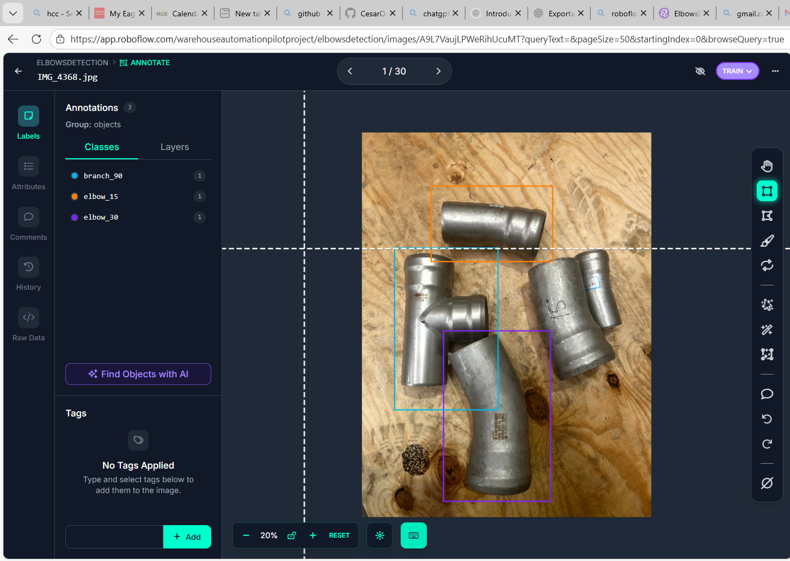
Warehouse Automation
Future Work
Add more classes (box, label, size, type)
Expand dataset beyond 30 images
Add OCR to read labels
Improve accuracy with augmentations
Deploy on edge devices

